Slide 1
JAVA 실행과정

Slide 2
CASE 1
main( ) 만 실행하는 경우

Slide 3
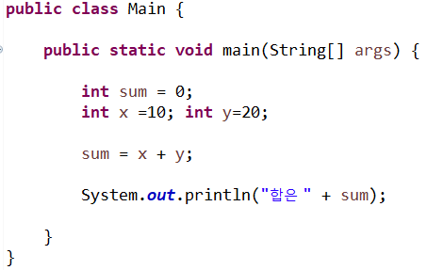
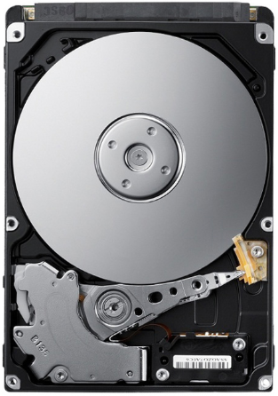
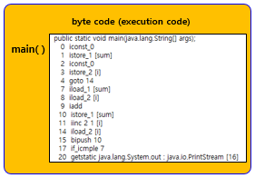
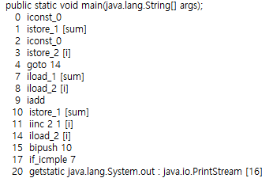
Main.java (소스코드) in HDD
HDD
Main.java
Main.class
Compile
Main.class in HDD
main( )
byte code (execution code)

Slide 4
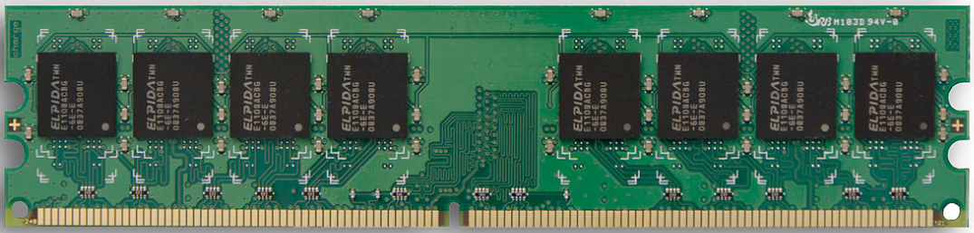
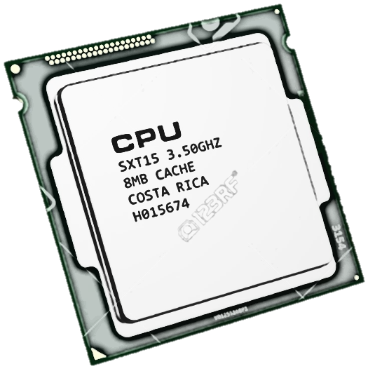
main ( ) 실행
Main Memory
명령(실행코드)는 클래스 안의 메소드 코드영역에서 !!!,
Method Area
Main.class
main( )
byte code (execution code)
code
CPU
HDD
1 istore_1 [sum]
sum
Main.java
sum
Heap
Main.class
data
코드를 실행할 때 필요한 데이터(변수)는 스택프레임에서 !!!
class load
Stack
stackframe 생성
main ( )
stackframe
x
y
sum
main( ) stackframe ➔ main 메소드를 실행하는 과정에서 필요한 데이터(변수)를 저장하는 메모리 공간

Slide 5
CASE 2
main( )에서 다른 메소드를 호출 실행하는 경우

Slide 6
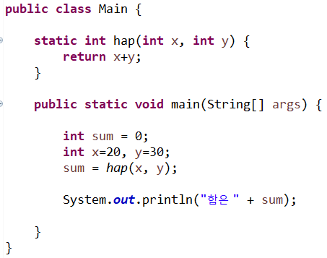
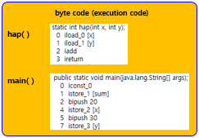

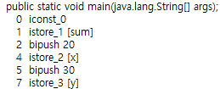
Main.java in HDD
HDD
Main.java
Main.class
Main.class in HDD
Compile
hap( )
byte code (execution code)
main( )

Slide 7
main ( ) 실행
Main Memory
Method Area
Main.class
hap( )
byte code (execution code)
HDD
Main.java
main( )
code
CPU
1 istore_1 [sum]
sum
Heap
sum
Main.class
data
class load
Stack
stackframe 생성
main ( )
stackframe
x
y
sum

Slide 8
hap ( ) 실행
Main Memory
Method Area
Main.class
hap( )
byte code (execution code)
HDD
main( )
code
CPU
Main.java
0 iload_0 [x]
x
Heap
x
Main.class
data
Stack
stackframe 생성
hap ( )
stackframe
x
y
main ( )
stackframe
x
y
sum

Slide 9
hap( ) 실행 후, main( ) 실행
Main Memory
Method Area
Main.class
hap( )
byte code (execution code)
HDD
Main.java
main( )
code
CPU
1 istore_1 [sum]
sum
Heap
sum
Main.class
data
Stack
main ( )
stackframe
x
y
sum

Slide 10
CASE 3
main( ) 에서 객체를 생성하여 실행하는 경우

Slide 11
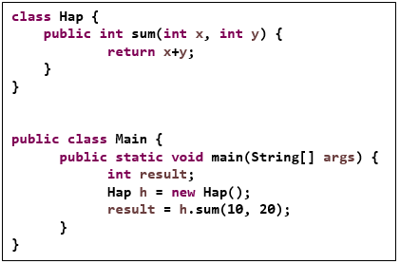
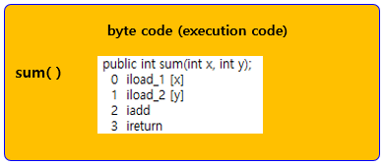

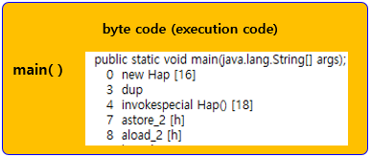

Main.java in HDD
class Hap {
public int sum(int x, int y) {
return x+y;
}
}
public class Main {
public static void main(String[] args) {
int result;
Hap h = new Hap();
result = h.sum(10, 20);
}
}
HDD
Main.java
Hap.class
Compile
Main.class in HDD
Compile
main( )
byte code (execution code)
Main.class
sum( )
byte code (execution code)
Hap.class in HDD

Slide 12
main( ) 실행
Main Memory
Method Area
HDD
Main.java
Main.class
CPU
code
0 new Hap [16]
h
Hap.class
Heap
data
h
Main.class
Stack
class load
stackframe 생성
main ( )
stackframe
h
result

Slide 13
Hap h = new Hap(); 실행
Main Memory
Method Area
Hap.class
HDD
class load
Main.java
100
Main.class
객체 생성
CPU
new
code
0 new Hap [16]
h
Hap.class
Heap
Hap 클래스 객체
sum ( ) : 100
data
1234
Main.class
Stack
main ( )
stackframe
1234
result
h

Slide 14
result = h.sum(10, 20); 실행
Main Memory
Method Area
Hap.class
HDD
Main.java
100
Main.class
CPU
code
0 iload_1 [x]
x
Hap.class
Heap
sum ( ) : 100
data
1234
Main.class
Stack
stackframe 생성
sum ( )
stackframe
10
20
x
y
main ( )
stackframe
1234
result
h

Slide 15
result = h.sum(10, 20); 실행 후
Main Memory
Method Area
Hap.class
HDD
Main.java
100
Main.class
CPU
code
0 iload_1 [x]
result
Hap.class
Heap
sum ( ) : 100
data
1234
Main.class
Stack
main ( )
stackframe
30
1234
result
h

